Slide 1
A Tutorial on Spectral Clustering
Von Luxburg, Ulrike
2007
Renmin University of China
11/24/2021

Slide 2
Content
Similarity graphs
Graph Laplacians and their basic properties
Spectral Clustering Algorithms
Graph cut point of view
Random walks point of view
Perturbation theory of view
Practical details reading
Outlook and further
Renmin University of China
11/24/2021

Slide 3
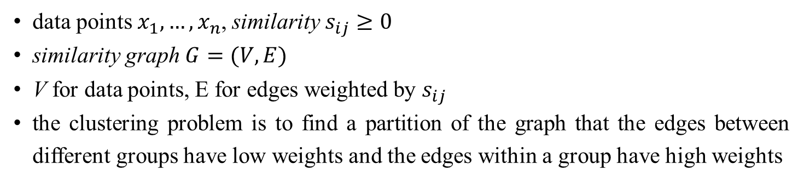
Similarity graphs
data points $x_{1}, …, x_{n}$, similarity $s_{ij}≥0$
similarity graph $G=(V,E)$
V for data points, E for edges weighted by $s_{ij}$
the clustering problem is to find a partition of the graph that the edges between different groups have low weights and the edges within a group have high weights
Renmin University of China
11/24/2021

Slide 4
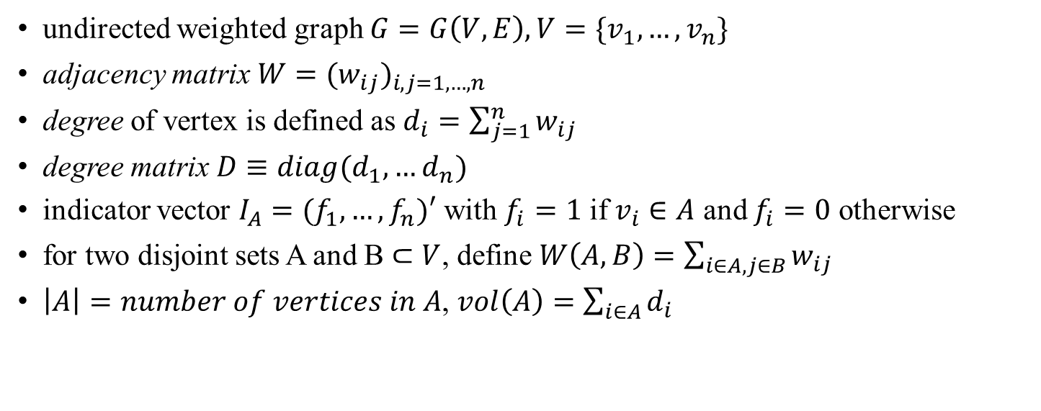
Similarity graphs
undirected weighted graph $G=G\left(V,E\right), V=\{v_{1},…,v_{n}\}$
adjacency matrix $W=(w_{ij})_{i,j=1,…,n}$
degree of vertex is defined as $d_{i}=\sum_{j=1}^{n}{w_{ij}}$
degree matrix $D≡diag(d_{1},…d_{n})$
indicator vector $I_{A}=(f_{1},…,f_{n})′$ with $f_{i}=1$ if $v_{i}∈A$ and $f_{i}=0$ otherwise
for two disjoint sets A and B $⊂V$, define $W\left(A, B\right)=\sum_{i∈A,j∈B}{w_{ij}}$
$\left|A\right|=number of vertices in A$, $vol\left(A\right)=\sum_{i∈A}{d_{i}}$
Renmin University of China
11/24/2021

Slide 5
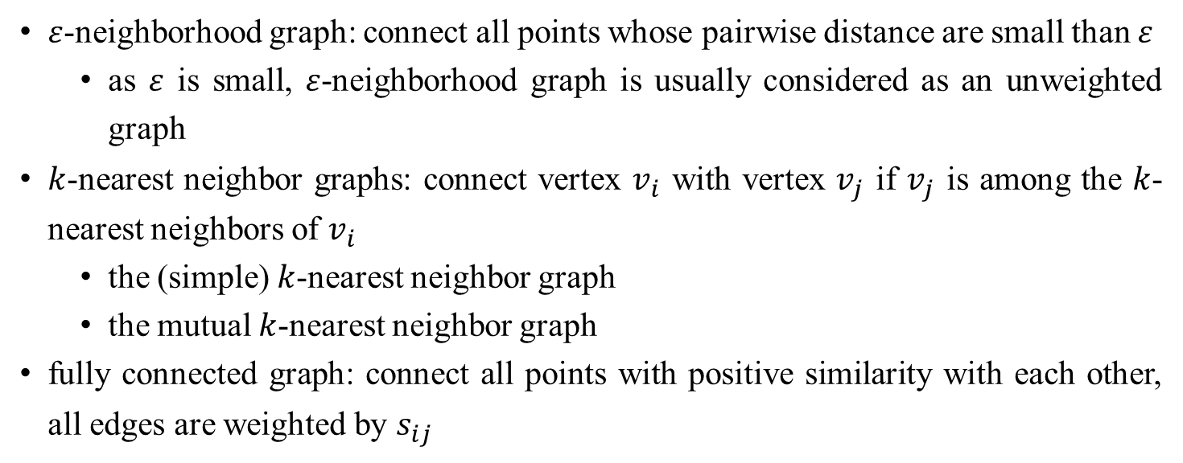
Similarity graphs
$ε$-neighborhood graph: connect all points whose pairwise distance are small than $ε$
as $ε$ is small, $ε$-neighborhood graph is usually considered as an unweighted graph
$k$-nearest neighbor graphs: connect vertex $v_{i}$ with vertex $v_{j}$ if $v_{j}$ is among the $k$-nearest neighbors of $v_{i}$
the (simple) $k$-nearest neighbor graph
the mutual $k$-nearest neighbor graph
fully connected graph: connect all points with positive similarity with each other, all edges are weighted by $s_{ij}$
Renmin University of China
11/24/2021

Slide 6
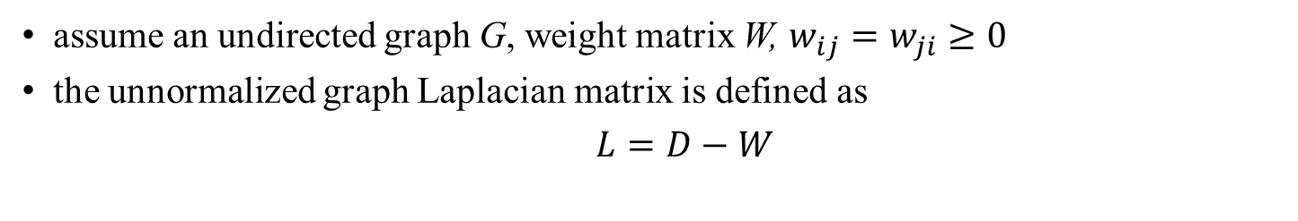
Graph Laplacians and their basic properties
assume an undirected graph G, weight matrix W, $w_{ij}=w_{ji}≥0$
the unnormalized graph Laplacian matrix is defined as
$L=D−W$
Renmin University of China
11/24/2021

Slide 7
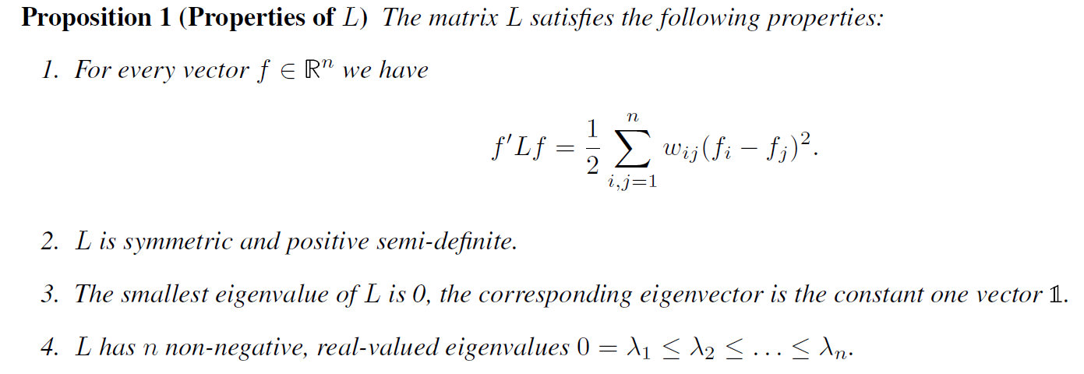
Graph Laplacians and their basic properties
Renmin University of China
11/24/2021

Slide 8
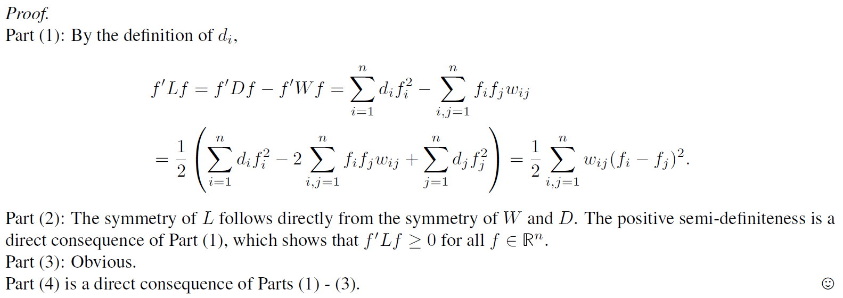
Graph Laplacians and their basic properties
Renmin University of China
11/24/2021

Slide 9
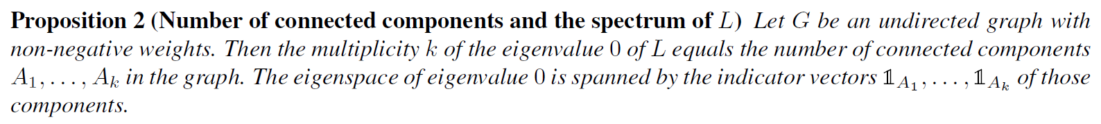
Graph Laplacians and their basic properties
Renmin University of China
11/24/2021

Slide 10
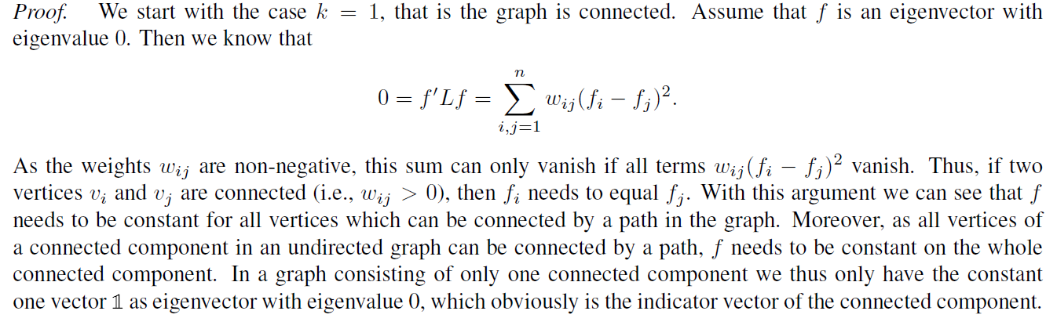
Graph Laplacians and their basic properties
Renmin University of China
11/24/2021

Slide 11
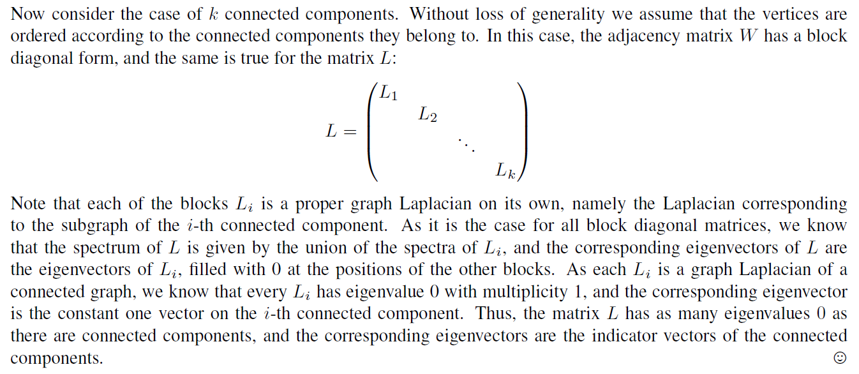
Graph Laplacians and their basic properties
Renmin University of China
11/24/2021

Slide 12
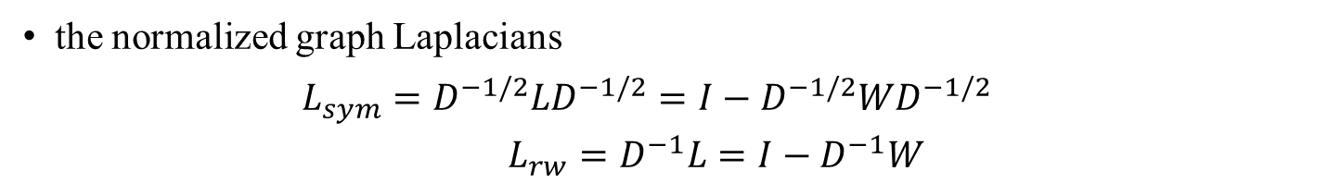
Graph Laplacians and their basic properties
the normalized graph Laplacians
$$L_{sym}=D^{−1/2}LD^{−1/2}=I−D^{−1/2}WD^{−1/2}$$
$L_{rw}=D^{−1}L=I−D^{−1}W$
Renmin University of China
11/24/2021

Slide 13
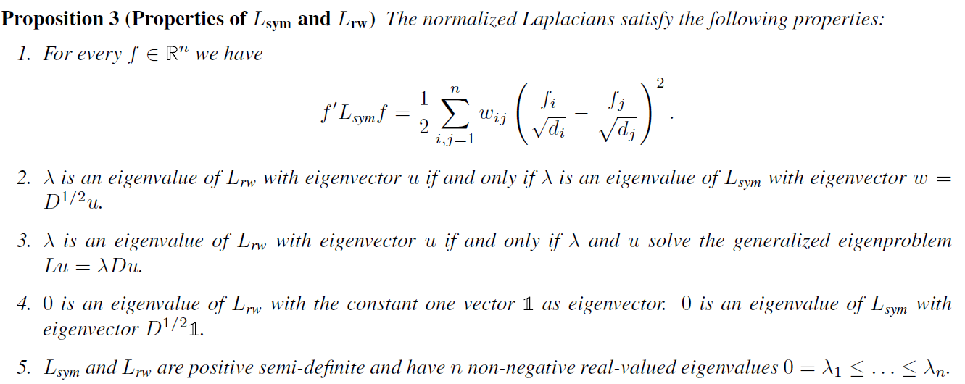
Graph Laplacians and their basic properties
Renmin University of China
11/24/2021

Slide 14
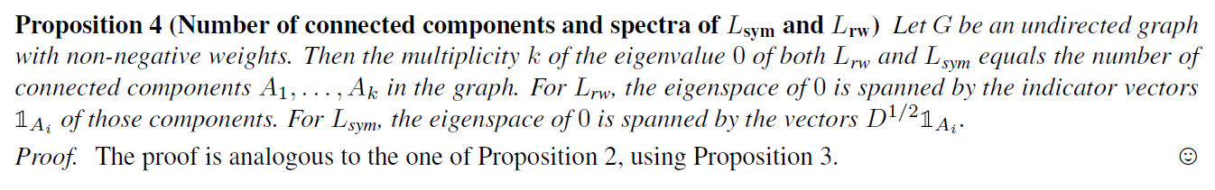
Graph Laplacians and their basic properties
Renmin University of China
11/24/2021

Slide 15
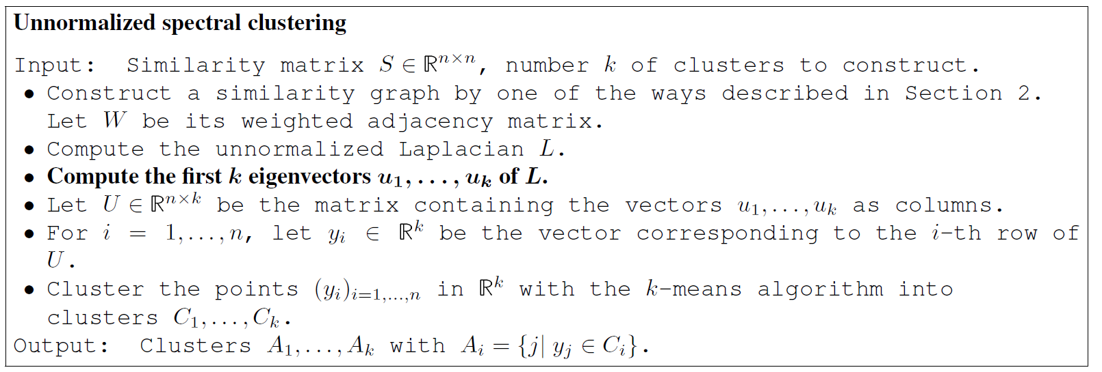
Spectral Clustering Algorithms
Renmin University of China
11/24/2021

Slide 16
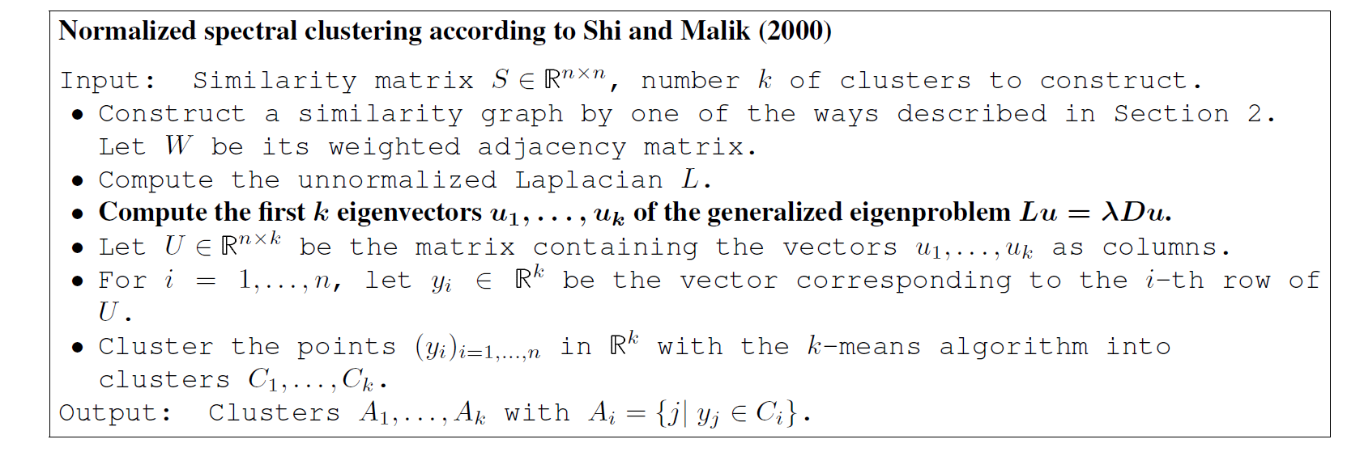
Spectral Clustering Algorithms
Renmin University of China
11/24/2021

Slide 17
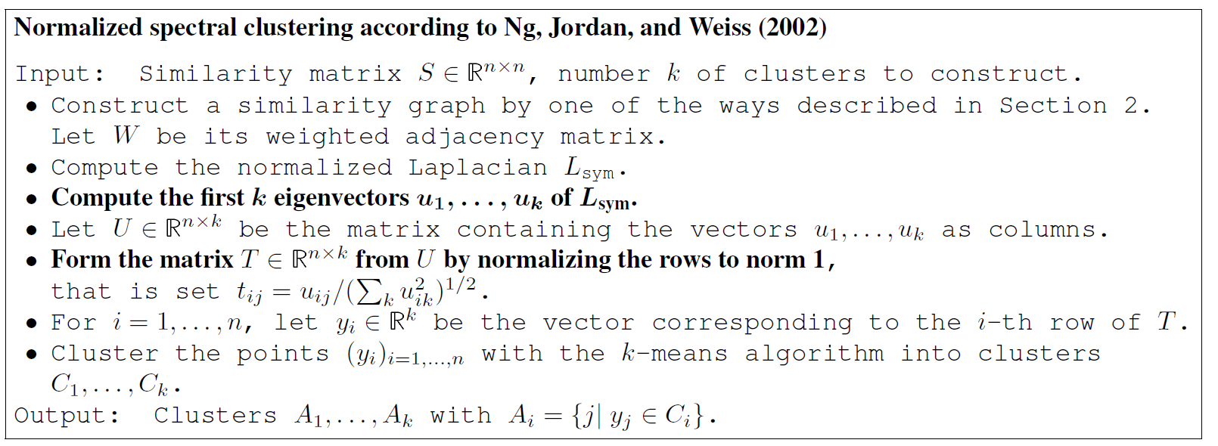
Spectral Clustering Algorithms
Renmin University of China
11/24/2021

Slide 18
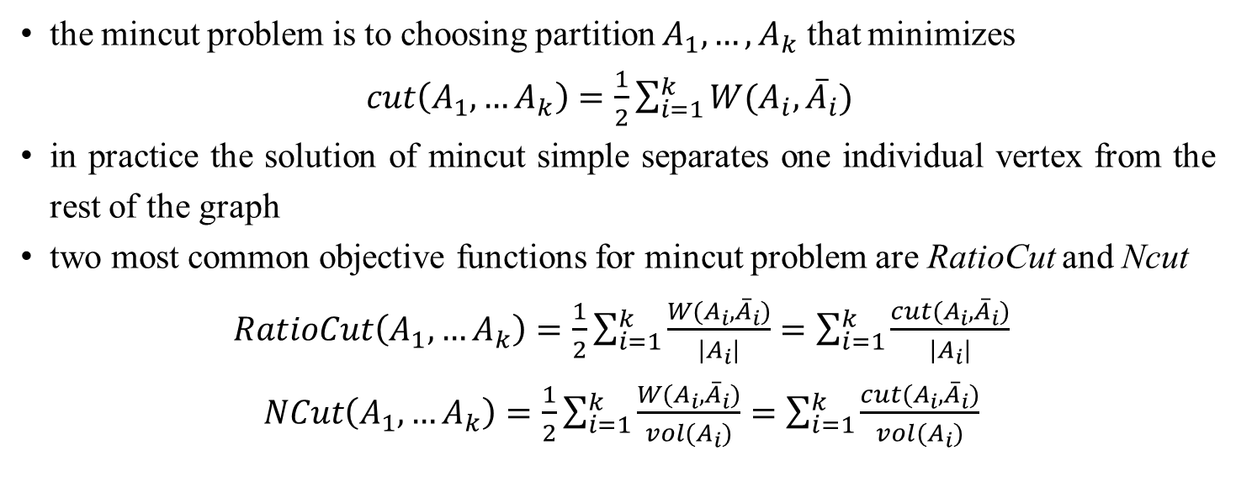
Graph cut point of view
the mincut problem is to choosing partition $A_{1},…,A_{k}$ that minimizes
$cut\left(A_{1},…A_{k}\right)=\frac{1}{2}\sum_{i=1}^{k}{W(A_{i},{\overline{A}}_{i})}$
in practice the solution of mincut simple separates one individual vertex from the rest of the graph
two most common objective functions for mincut problem are RatioCut and Ncut
$RatioCut\left(A_{1},…A_{k}\right)=\frac{1}{2}\sum_{i=1}^{k}{\frac{W(A_{i},{\overline{A}}_{i})}{|A_{i}|}}=\sum_{i=1}^{k}{\frac{cut(A_{i},{\overline{A}}_{i})}{|A_{i}|}}$
$NCut\left(A_{1},…A_{k}\right)=\frac{1}{2}\sum_{i=1}^{k}{\frac{W(A_{i},{\overline{A}}_{i})}{vol(A_{i})}}=\sum_{i=1}^{k}{\frac{cut(A_{i},{\overline{A}}_{i})}{vol(A_{i})}}$
Renmin University of China
11/24/2021

Slide 19
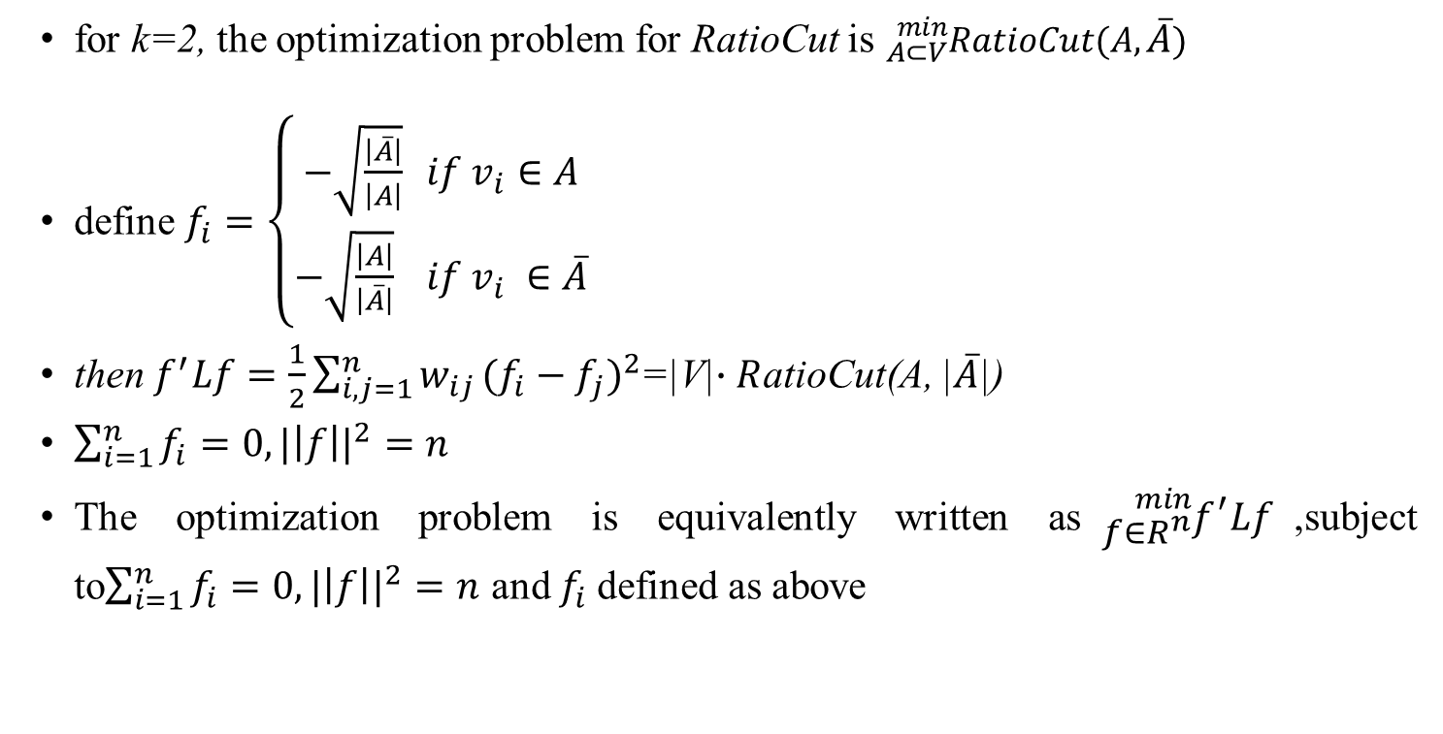
Graph cut point of view
for k=2, the optimization problem for RatioCut is ${}_{A⊂V}^{min}{RatioCut(A,\overline{A})}$
define $f_{i}=\left\{\begin{aligned}−\sqrt{\frac{\left|\overline{A}\right|}{\left|A\right|}} if v_{i}∈A \\ −\sqrt{\frac{\left|A\right|}{\left|\overline{A}\right|}} if v_{i} ∈\overline{A}\end{aligned}\right.$
then $f^{′}Lf=\frac{1}{2}\sum_{i,j=1}^{n}{w_{ij}}({f_{i}−f_{j})}^{2}$=|V|$∙R$atioCut(A, |$\overline{A}$|)
$\sum_{i=1}^{n}{f_{i}=0, {|\left|f\right||}^{2}=n}$
The optimization problem is equivalently written as${}_{f∈R^{n}}^{min}{f^{′}Lf}$,subject to$\sum_{i=1}^{n}{f_{i}=0, {|\left|f\right||}^{2}=n}$ and $f_{i}$defined as above
Renmin University of China
11/24/2021

Slide 20
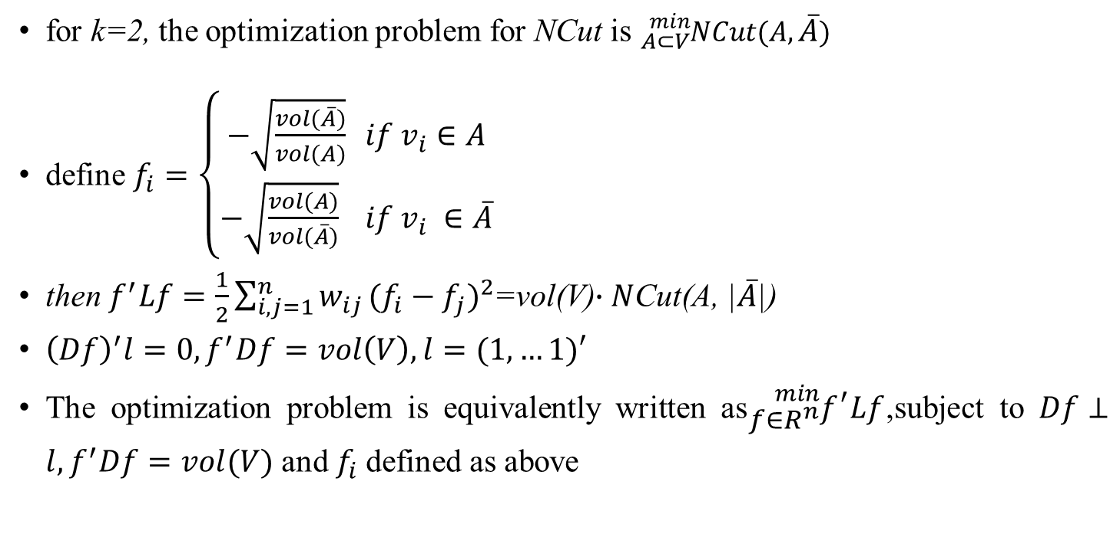
Graph cut point of view
for k=2, the optimization problem for NCut is ${}_{A⊂V}^{min}{NCut(A,\overline{A})}$
define $f_{i}=\left\{\begin{aligned}−\sqrt{\frac{vol(\overline{A})}{vol(A)}} if v_{i}∈A \\ −\sqrt{\frac{vol(A)}{vol(\overline{A})}} if v_{i} ∈\overline{A}\end{aligned}\right.$
then $f^{′}Lf=\frac{1}{2}\sum_{i,j=1}^{n}{w_{ij}}({f_{i}−f_{j})}^{2}$=vol(V)$∙N$Cut(A, |$\overline{A}$|)
${\left(Df\right)}^{′}l=0,f^{′}Df=vol\left(V\right),l=(1,…1)′$
The optimization problem is equivalently written as${}_{f∈R^{n}}^{min}{f^{′}Lf}$,subject to $Df⊥l,f^{′}Df=vol(V)$ and $f_{i}$defined as above
Renmin University of China
11/24/2021

Slide 21
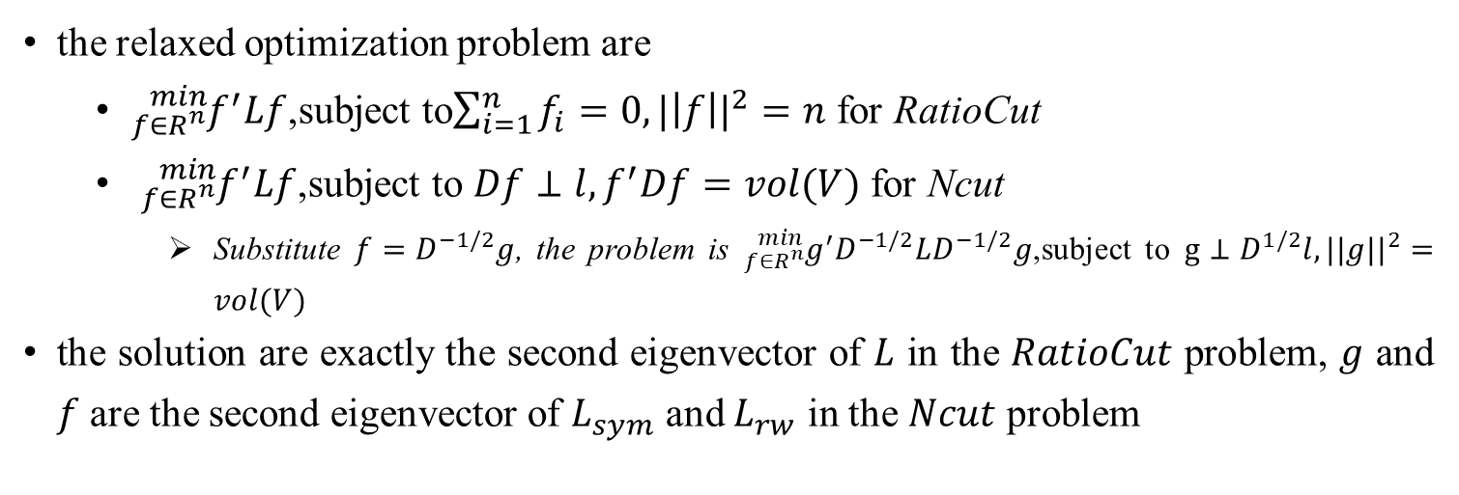
Graph cut point of view
the relaxed optimization problem are
${}_{f∈R^{n}}^{min}{f^{′}Lf}$,subject to$\sum_{i=1}^{n}{f_{i}=0, {|\left|f\right||}^{2}=n}$ for RatioCut
${}_{f∈R^{n}}^{min}{f^{′}Lf}$,subject to $Df⊥l,f^{′}Df=vol(V)$ for Ncut
Substitute $f=D^{−1/2}g$, the problem is ${}_{f∈R^{n}}^{min}{g^{′}D^{−1/2}LD^{−1/2}g}$,subject to $g⊥D^{1/2}l, {||g||}^{2}=vol(V)$
the solution are exactly the second eigenvector of $L$ in the $RatioCut$ problem, $g$ and $f$ are the second eigenvector of $L_{sym}$ and $L_{rw}$ in the $Ncut$ problem
Renmin University of China
11/24/2021

Slide 22
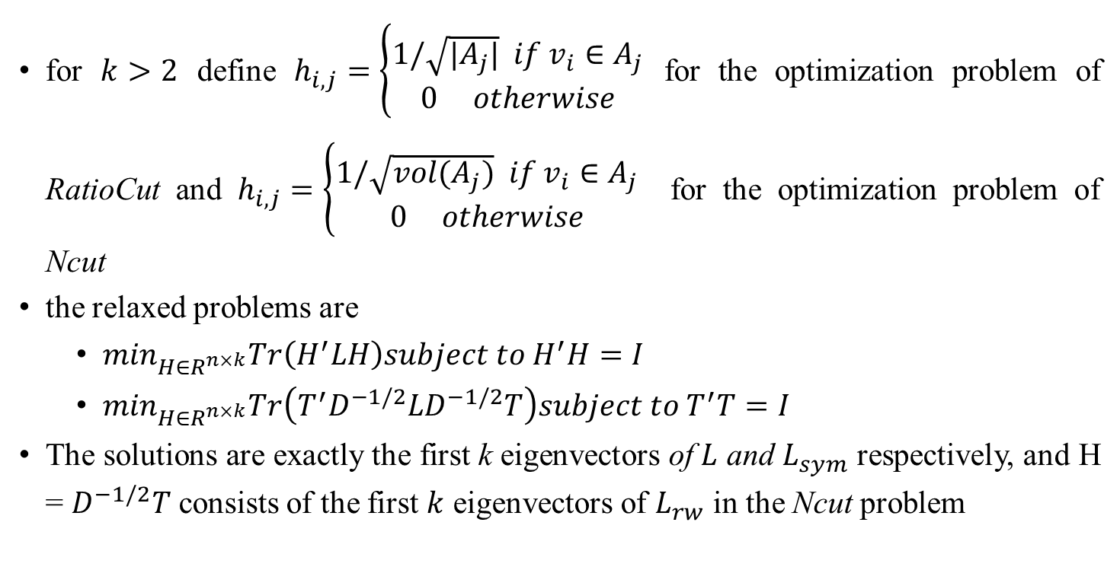
Graph cut point of view
for $k>2$ define $h_{i,j}=\left\{\begin{aligned}1/\sqrt{|A_{j}|} if v_{i}∈A_{j} \\ 0 otherwise\end{aligned}\right.$ for the optimization problem of RatioCut and $h_{i,j}=\left\{\begin{aligned}1/\sqrt{vol(A_{j})} if v_{i}∈A_{j} \\ 0 otherwise\end{aligned}\right.$ for the optimization problem of Ncut
the relaxed problems are
$\min_{H∈R^{n×k}}Tr\left(H^{′}LH\right)subject to H^{′}H=I$
$\min_{H∈R^{n×k}}Tr\left(T^{′}D^{−1/2}LD^{−1/2}T\right)subject to T^{′}T=I$
The solutions are exactly the first k eigenvectors of $L$ and $L_{sym}$ respectively, and H = $D^{−1/2}T$ consists of the first $k$ eigenvectors of $L_{rw}$ in the Ncut problem
Renmin University of China
11/24/2021

Slide 23
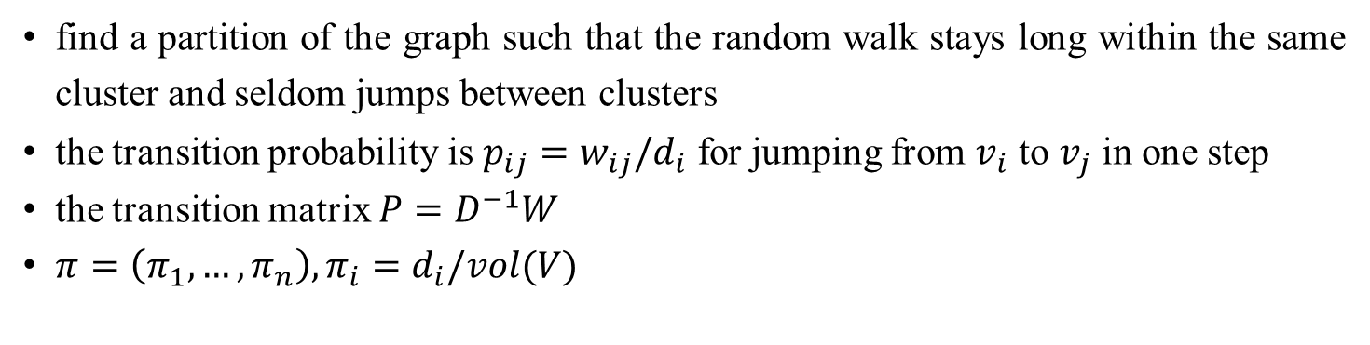
Random walks point
find a partition of the graph such that the random walk stays long within the same cluster and seldom jumps between clusters
the transition probability is $p_{ij}=w_{ij}/d_{i}$ for jumping from $v_{i}$ to $v_{j}$ in one step
the transition matrix $P=D^{−1}W$
$π=\left(π_{1},…,π_{n}\right), π_{i}=d_{i}/vol(V)$
Renmin University of China
11/24/2021

Slide 24
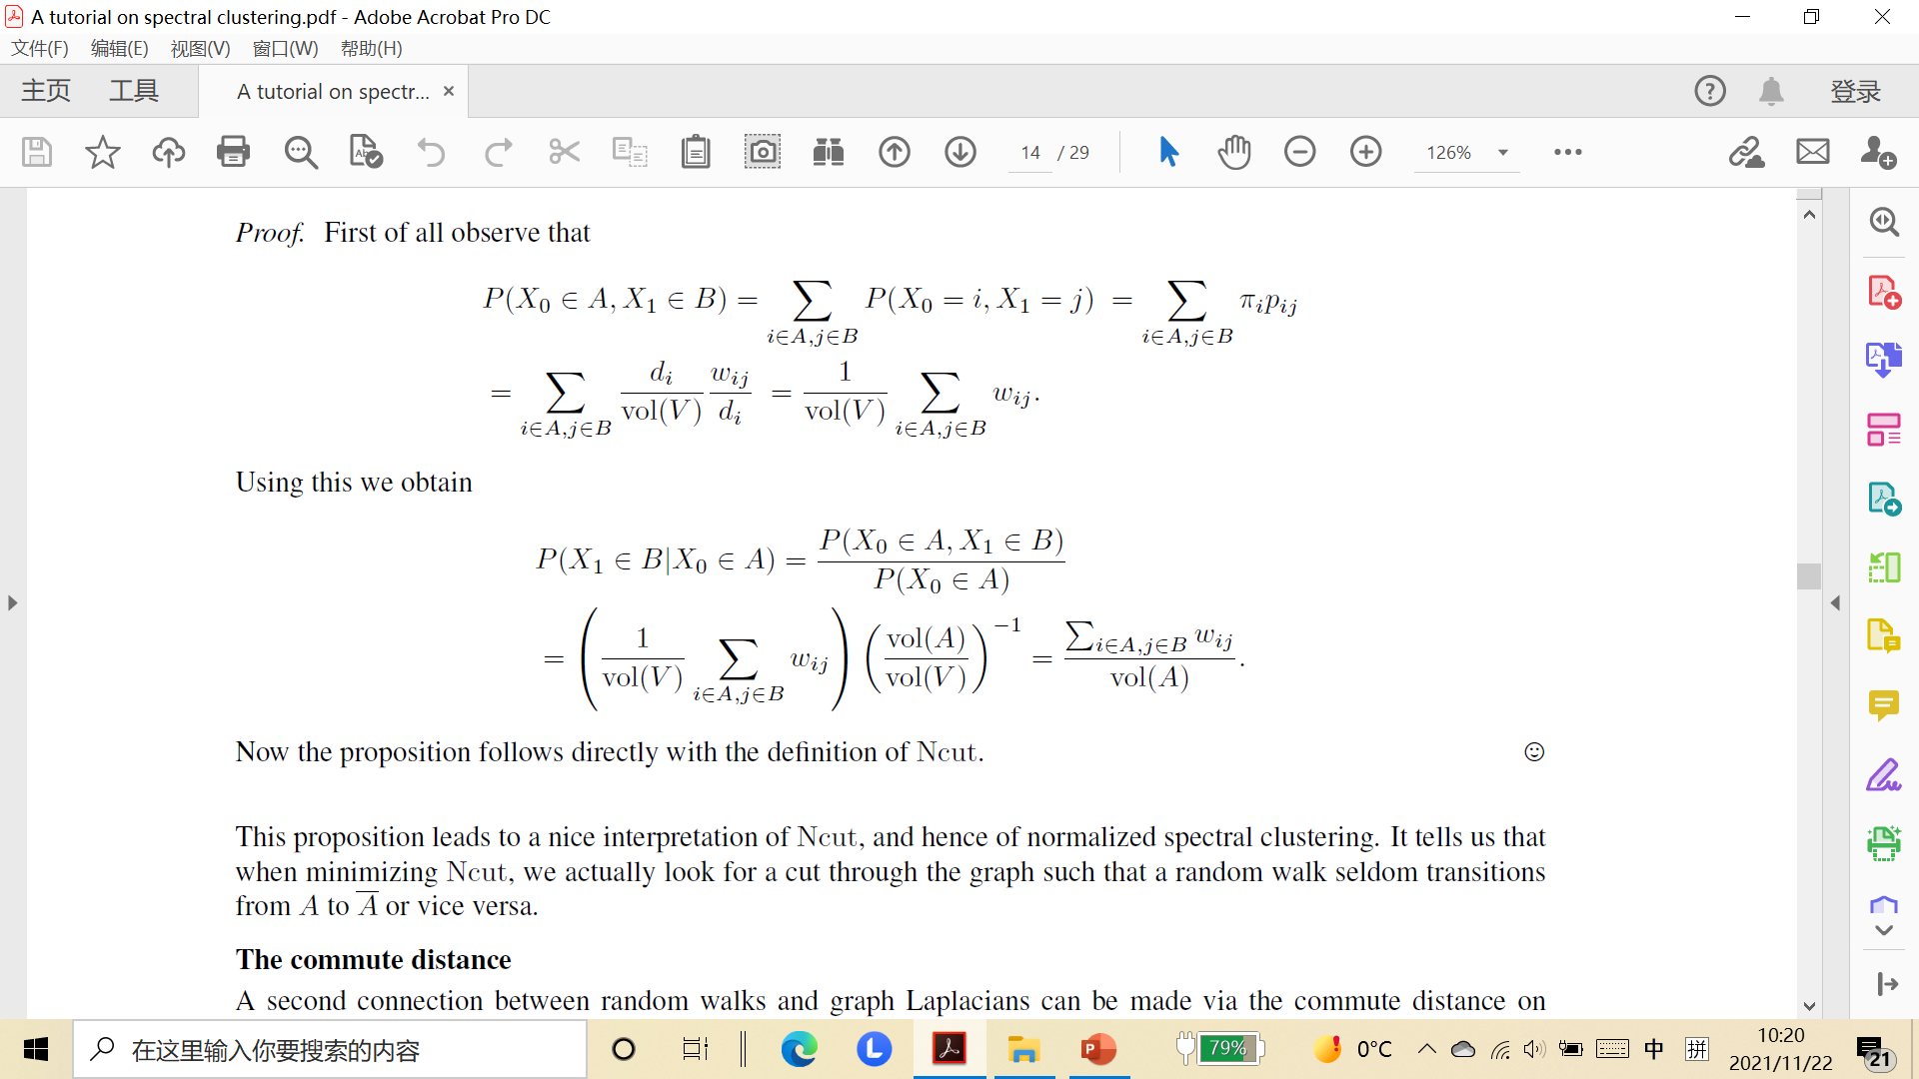
Random walks point
denote $P\left(B | A\right)≔P(X_{1}∈B|X_{0}∈A)$, then $Ncut\left(A,\overline{A}\right)=P\left(\overline{A} | A\right)+P(A|\overline{A})$
Renmin University of China
11/24/2021

Slide 25
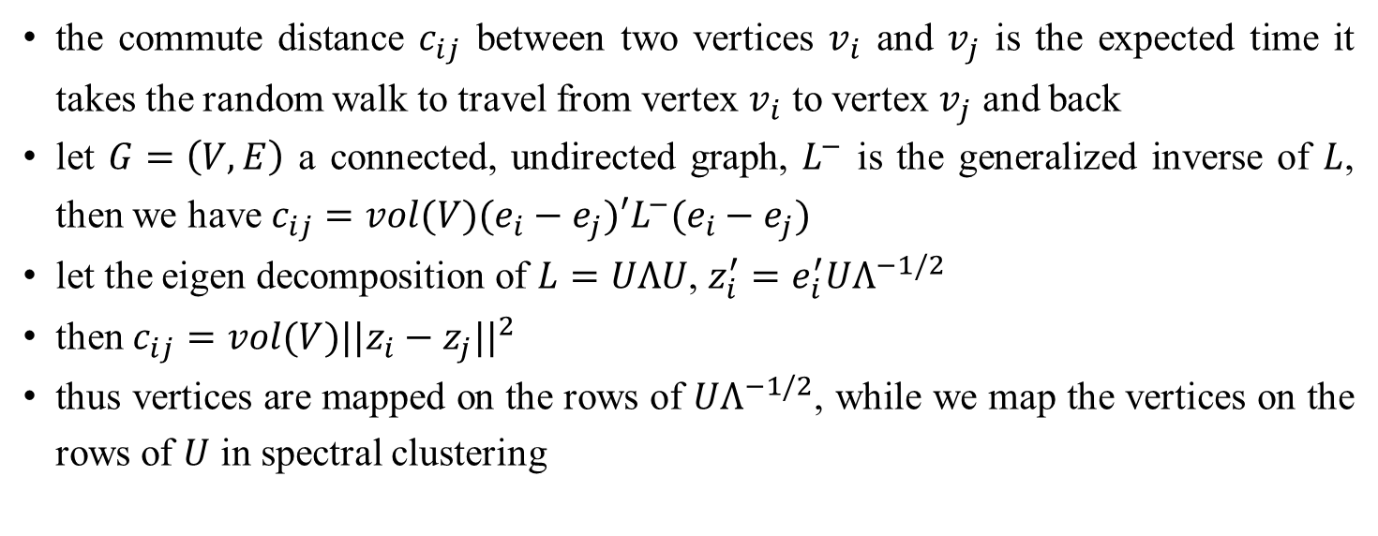
Random walks point of view
the commute distance $c_{ij}$ between two vertices $v_{i}$ and $v_{j}$ is the expected time it takes the random walk to travel from vertex $v_{i}$ to vertex $v_{j}$ and back
let $G=\left(V,E\right)$ a connected, undirected graph, $L^{−}$ is the generalized inverse of $L$, then we have $c_{ij}=vol(V)(e_{i}−e_{j})′L^{−}(e_{i}−e_{j})$
let the eigen decomposition of $L=UΛU$, $z_{i}^{′}=e_{i}^{′}UΛ^{−1/2}$
then $c_{ij}=vol(V){||z_{i}−z_{j}||}^{2}$
thus vertices are mapped on the rows of $UΛ^{−1/2}$, while we map the vertices on the rows of $U$ in spectral clustering
Renmin University of China
11/24/2021

Slide 26
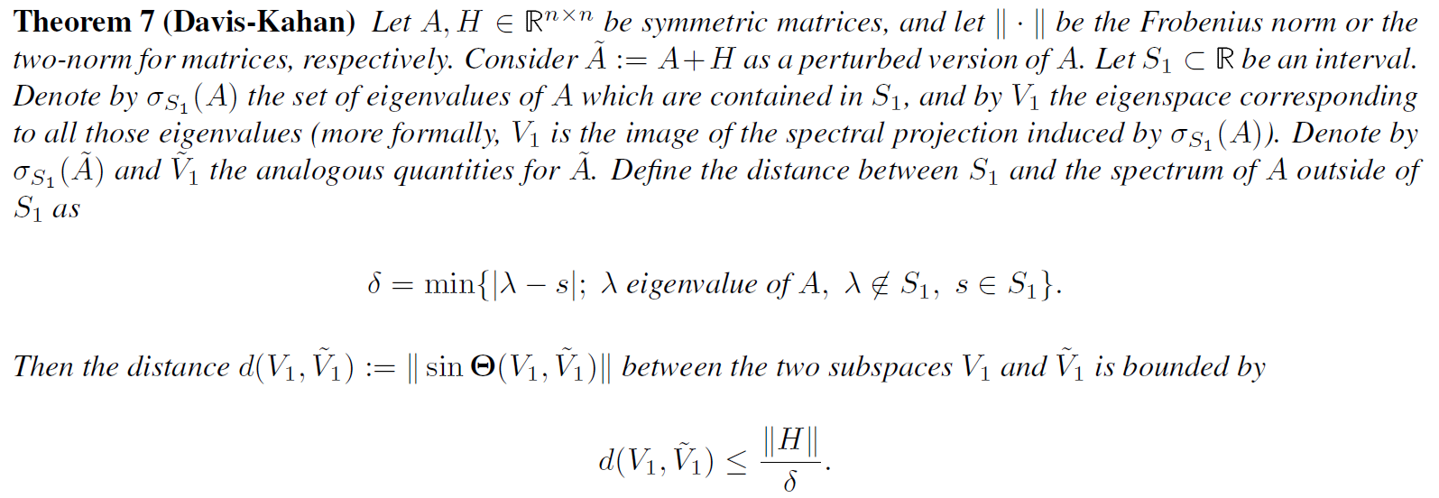
Perturbation theory point of view
Renmin University of China
11/24/2021

Slide 27
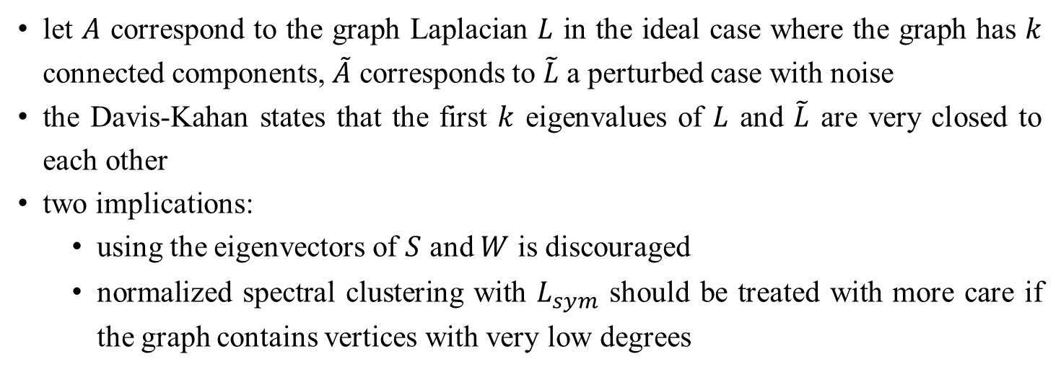
Perturbation theory point of view
let $A$ correspond to the graph Laplacian $L$ in the ideal case where the graph has $k$ connected components, $\tilde{A}$ corresponds to $\tilde{L}$ a perturbed case with noise
the Davis-Kahan states that the first $k$ eigenvalues of $L$ and $\tilde{L}$ are very closed to each other
two implications:
using the eigenvectors of $S$ and $W$ is discouraged
normalized spectral clustering with $L_{sym}$ should be treated with more care if the graph contains vertices with very low degrees
Renmin University of China
11/24/2021

Slide 28
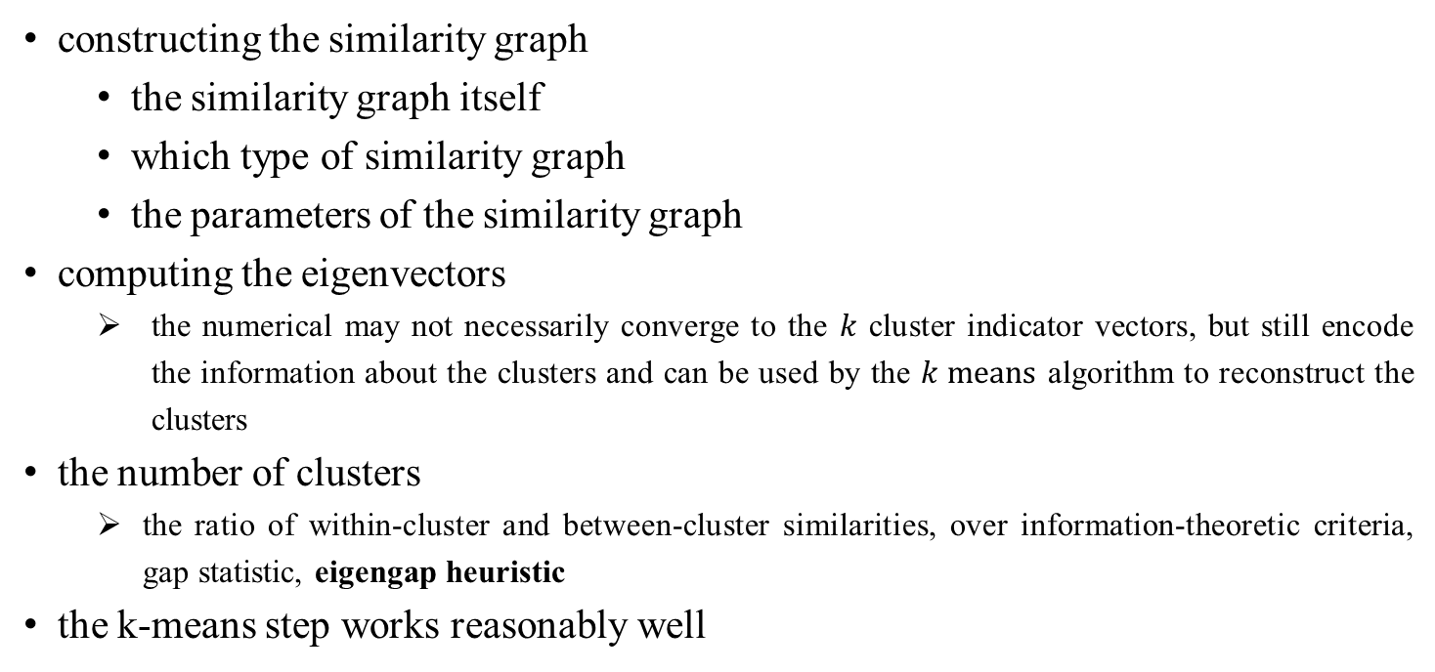
Practice details
constructing the similarity graph
the similarity graph itself
which type of similarity graph
the parameters of the similarity graph
computing the eigenvectors
the numerical may not necessarily converge to the $k$ cluster indicator vectors, but still encode the information about the clusters and can be used by the $k means$ algorithm to reconstruct the clusters
the number of clusters
the ratio of within-cluster and between-cluster similarities, over information-theoretic criteria, gap statistic, eigengap heuristic
the k-means step works reasonably well
Renmin University of China
11/24/2021

Slide 29
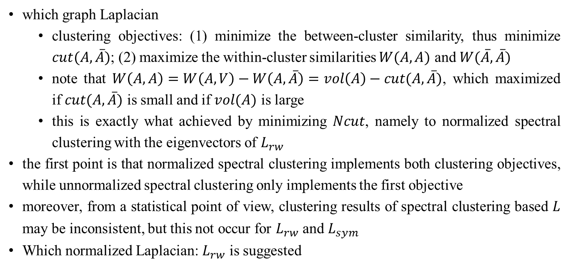
Practice details
which graph Laplacian
clustering objectives: (1) minimize the between-cluster similarity, thus minimize $cut(A,\overline{A})$; (2) maximize the within-cluster similarities $W(A, A)$ and $W(\overline{A},\overline{A})$
note that $W\left(A,A\right)=W\left(A,V\right)−W\left(A,\overline{A}\right)=vol\left(A\right)−cut(A,\overline{A})$, which maximized if $cut(A,\overline{A})$ is small and if $vol(A)$ is large
this is exactly what achieved by minimizing $Ncut$, namely to normalized spectral clustering with the eigenvectors of $L_{rw}$
the first point is that normalized spectral clustering implements both clustering objectives, while unnormalized spectral clustering only implements the first objective
moreover, from a statistical point of view, clustering results of spectral clustering based $L$ may be inconsistent, but this not occur for $L_{rw}$ and $L_{sym}$
Which normalized Laplacian: $L_{rw}$ is suggested
Renmin University of China
11/24/2021

Slide 30
Outlook and further reading
history of spectral clustering
spectral clustering in machine learning community
co-clustering problem
spectral clustering with additional side information
Relation of spectral clustering to other algorithms
the success of spectral clustering is mainly based on the fact that it does not make strong assumptions on the form of clusters
Renmin University of China
11/24/2021

